Slide 1
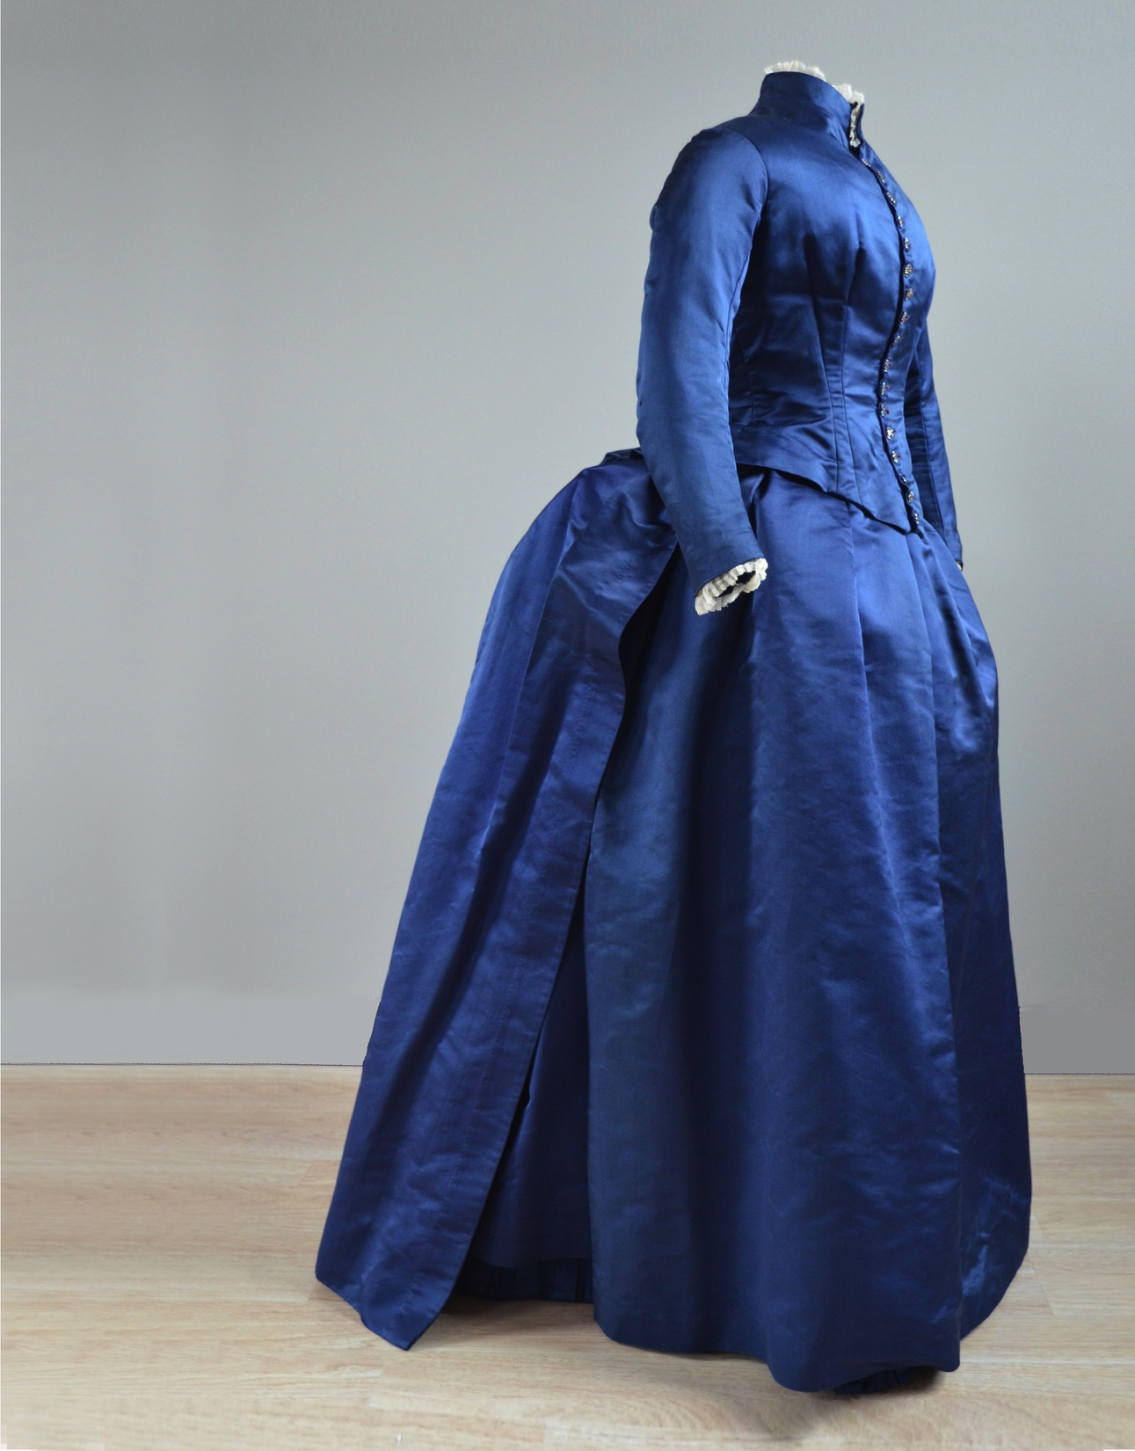
Displaying Three-Dimensional Textiles

Slide 2
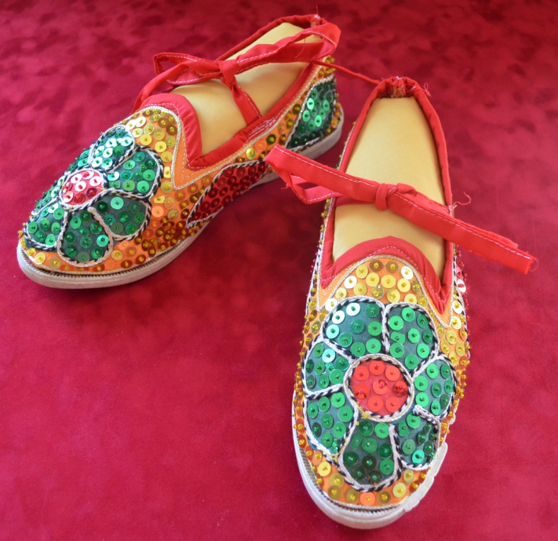
Methods of attachment
Passive
Pinned
Stitched
Pressure
Magnetic

Slide 3
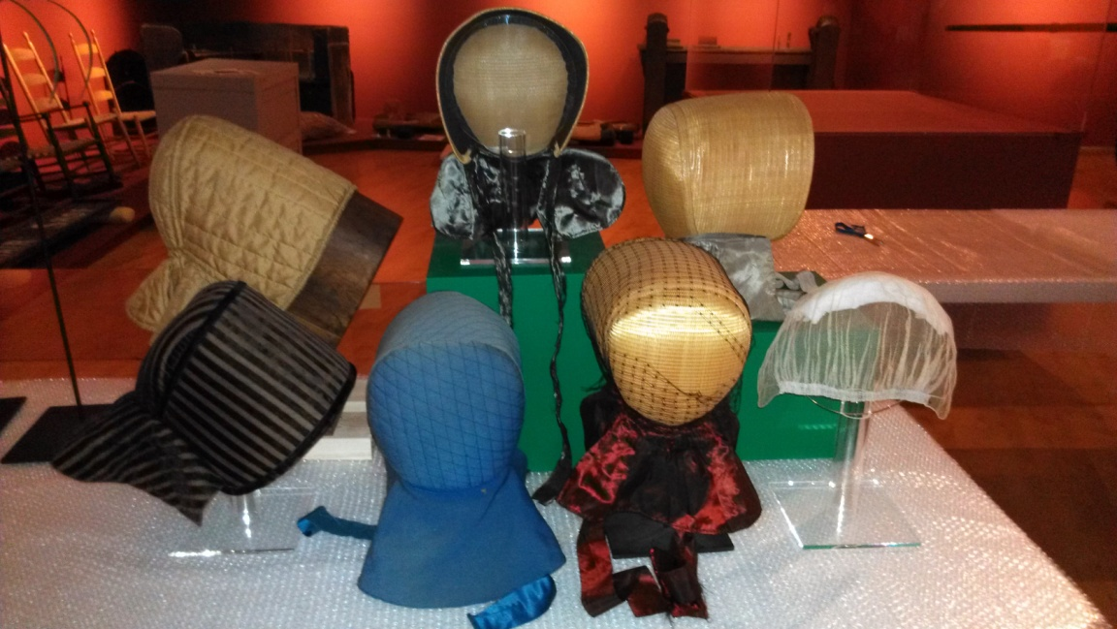
Passive

Slide 4
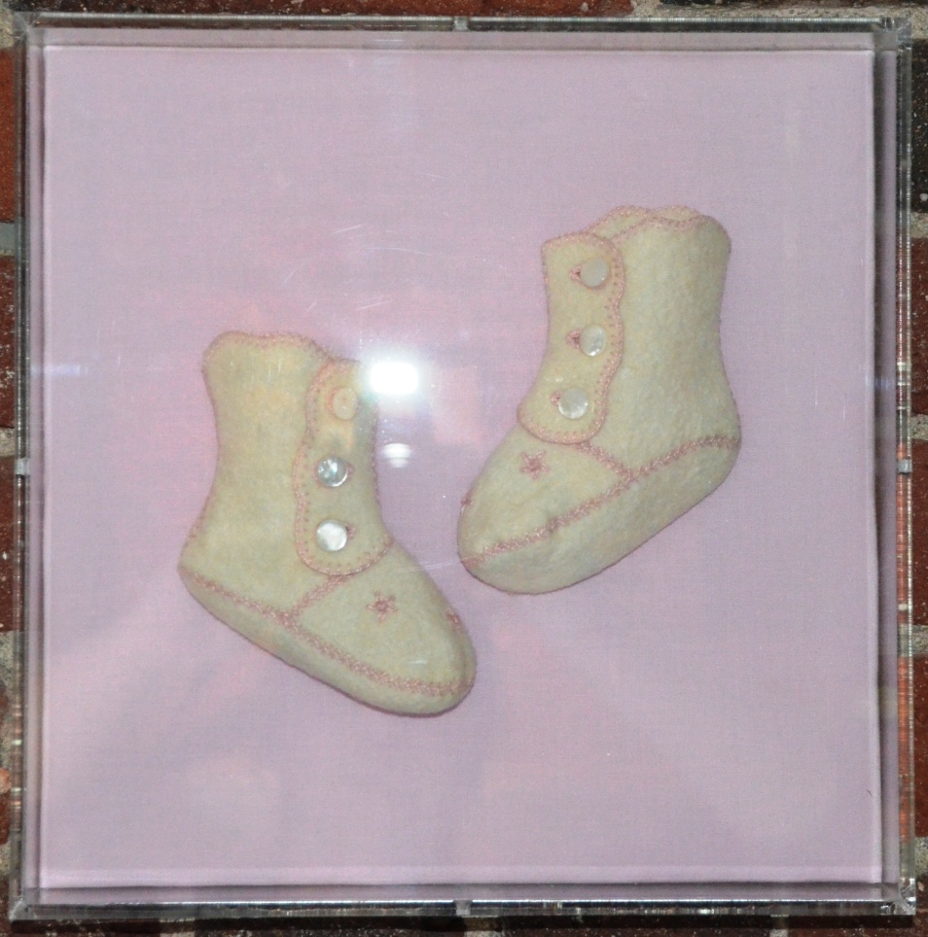
Forms of display
Board / Slant board
Rod / Manikin
Frame
Shadow box
Slat

Slide 5
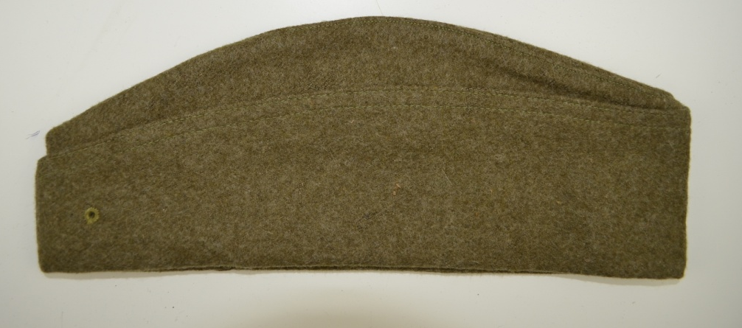

Slide 6
Pinned

Slide 7
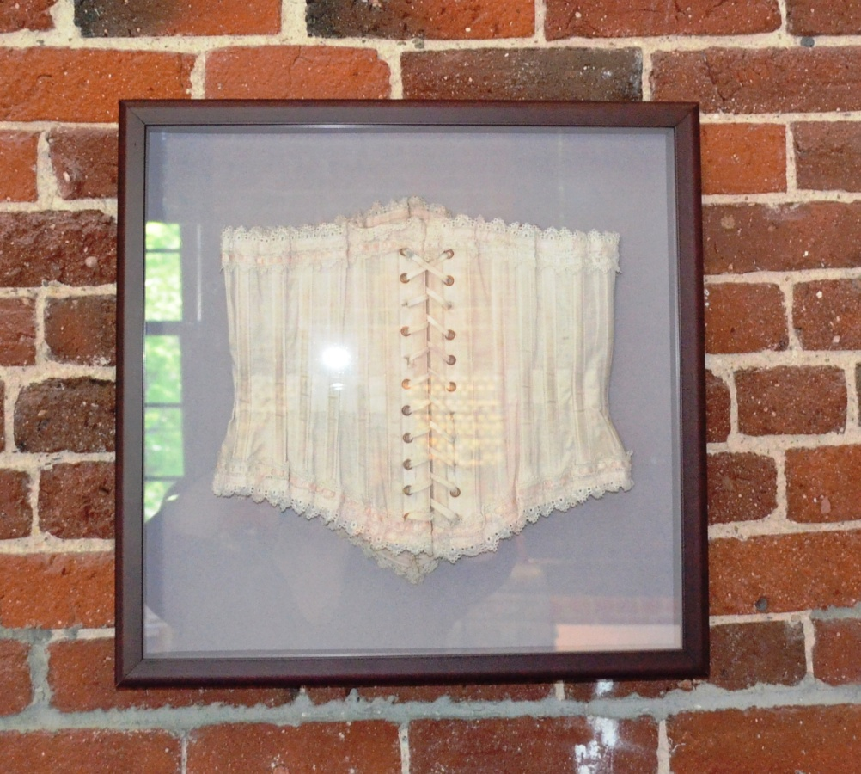
Stitched

Slide 8
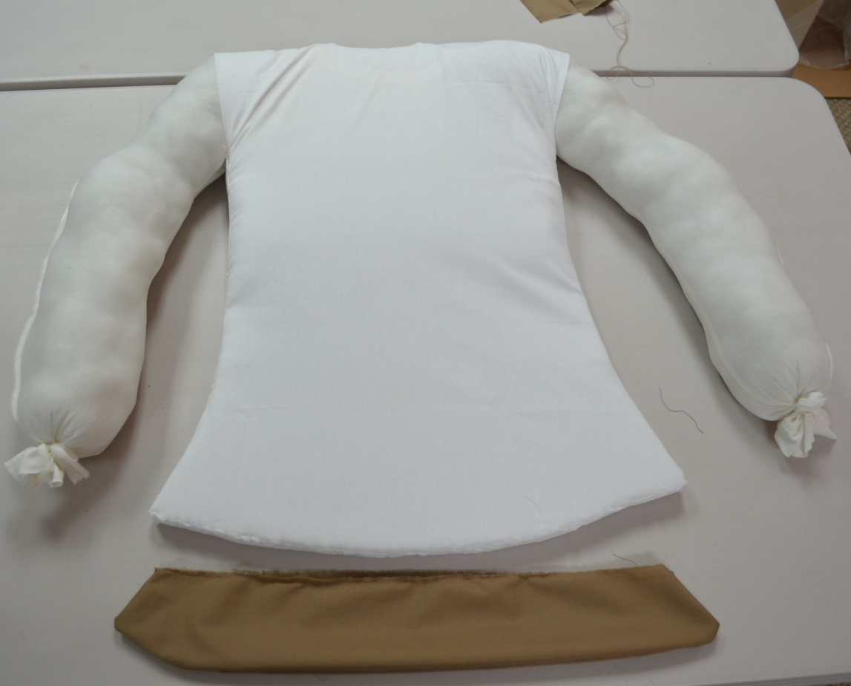
Variables of Support
Angle
Pressure
Attachment
Padding

Slide 9
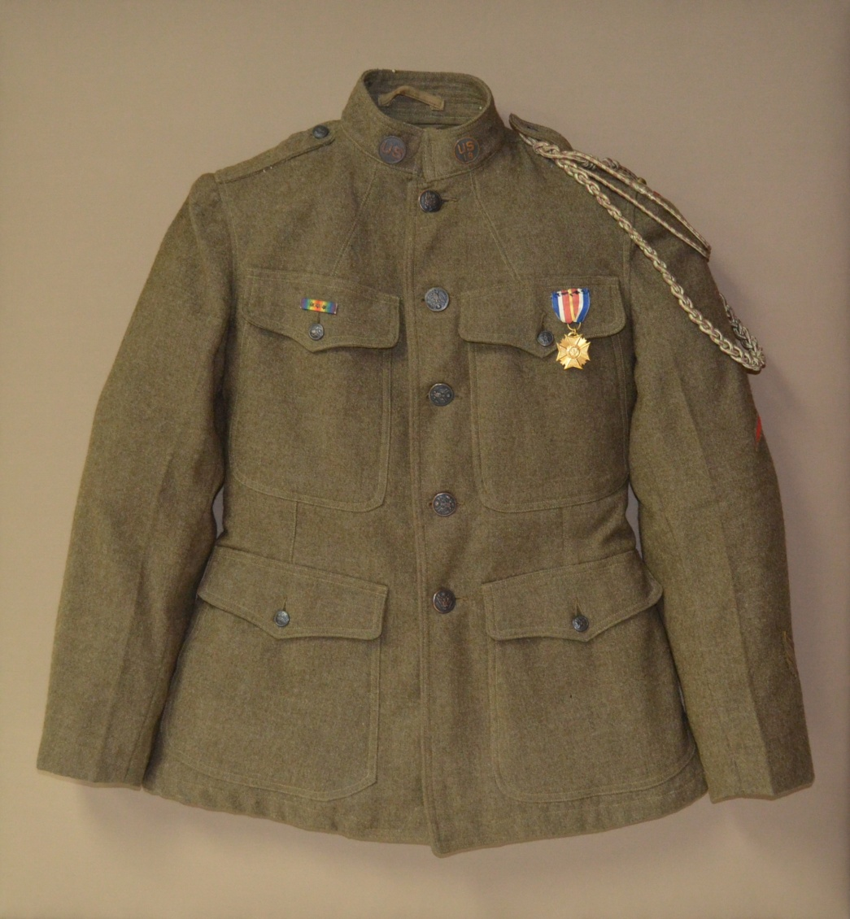

Slide 12
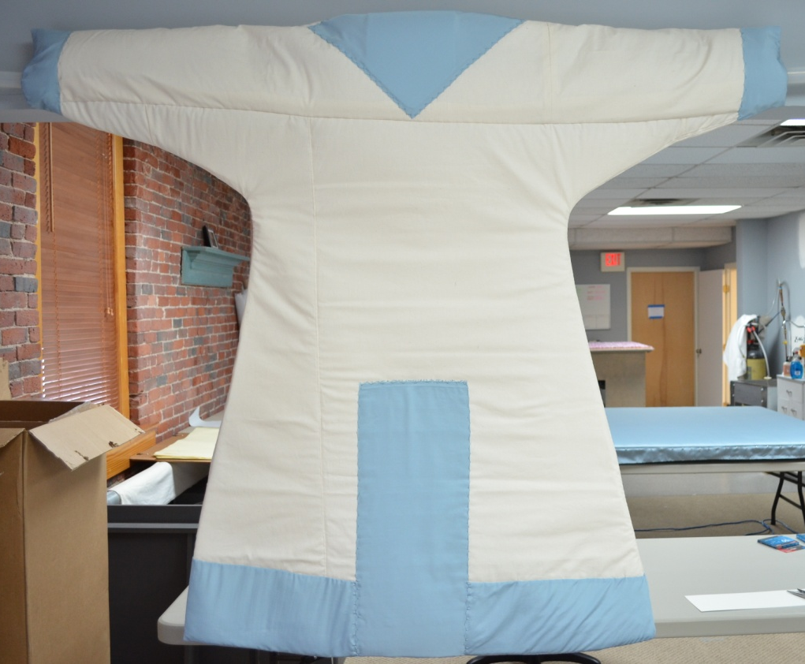

Slide 14
Break

Slide 15
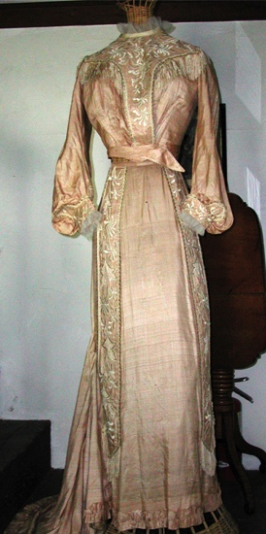
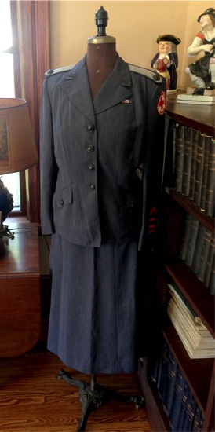
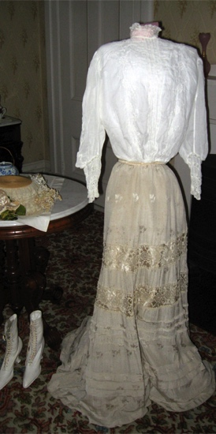
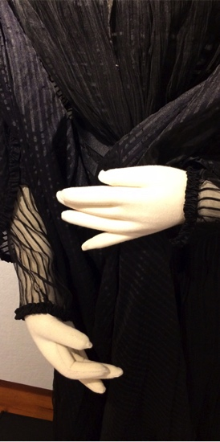
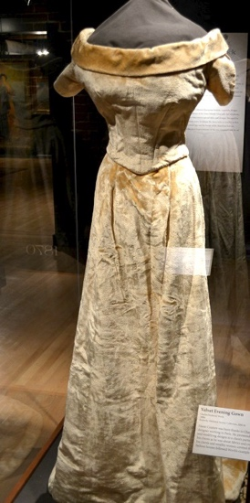
Costume mounting
All recent anonymous examples of costume mounting from small museums, historic houses, and societies across the New England region.

Slide 16
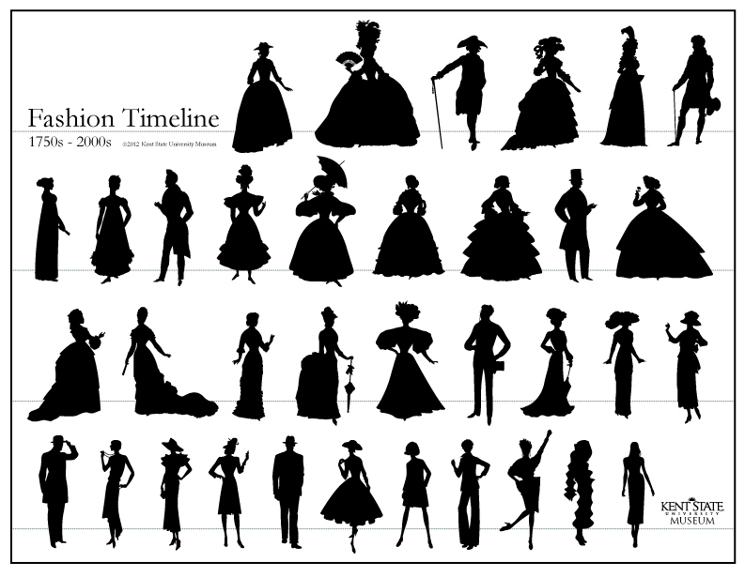
Fashion Timeline. Kent State University Museum, 2012.

Slide 17
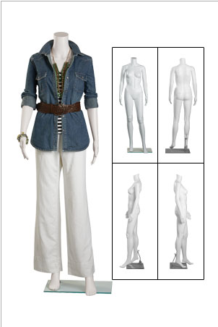
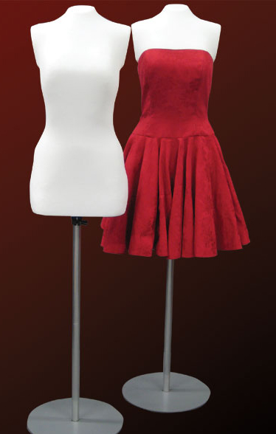
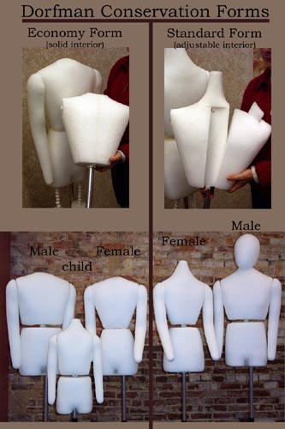
Commercial Options
Store Supply Warehouse
$54–95 Non-archival/non customizable or quite costly to do so
University Products
$826.75
Archival/customizable
Dorfman $625–1,845 Archival/customizable

Slide 18
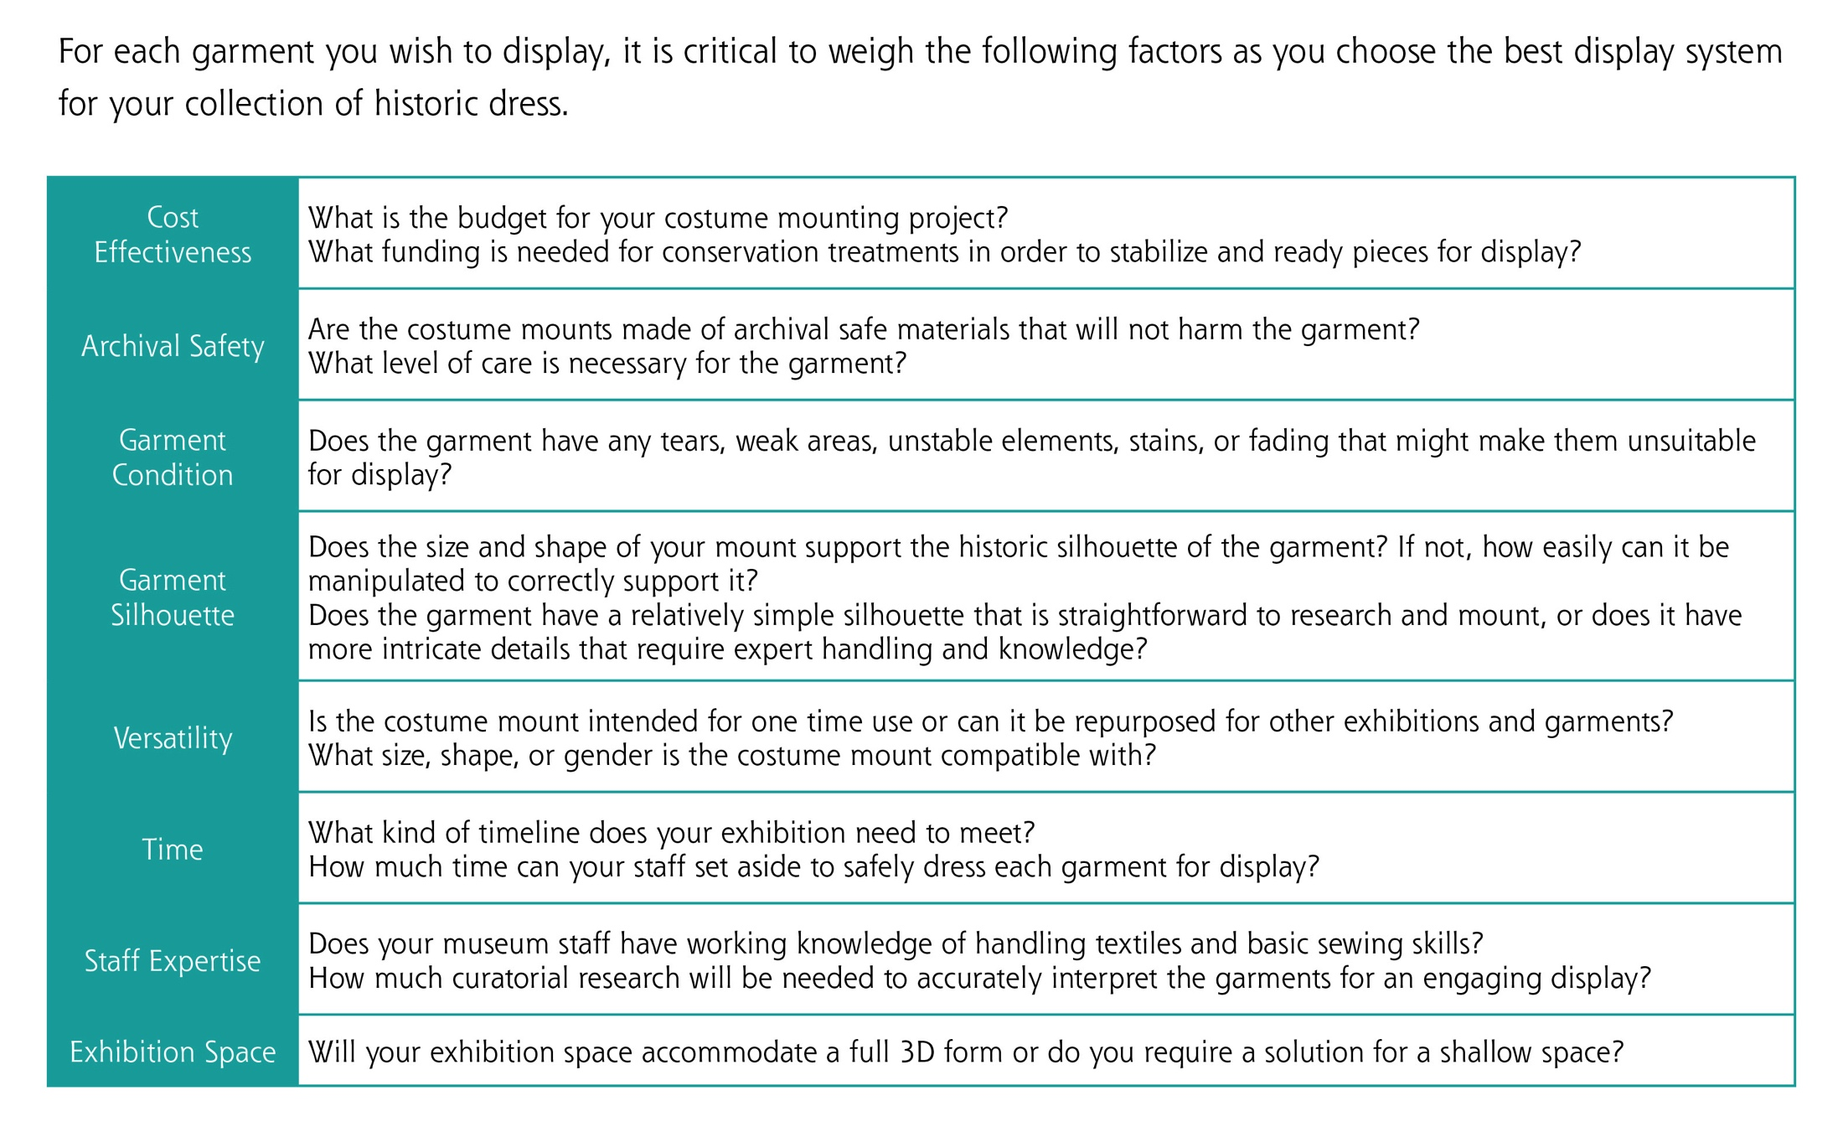
Display Systems Checklist

Slide 19
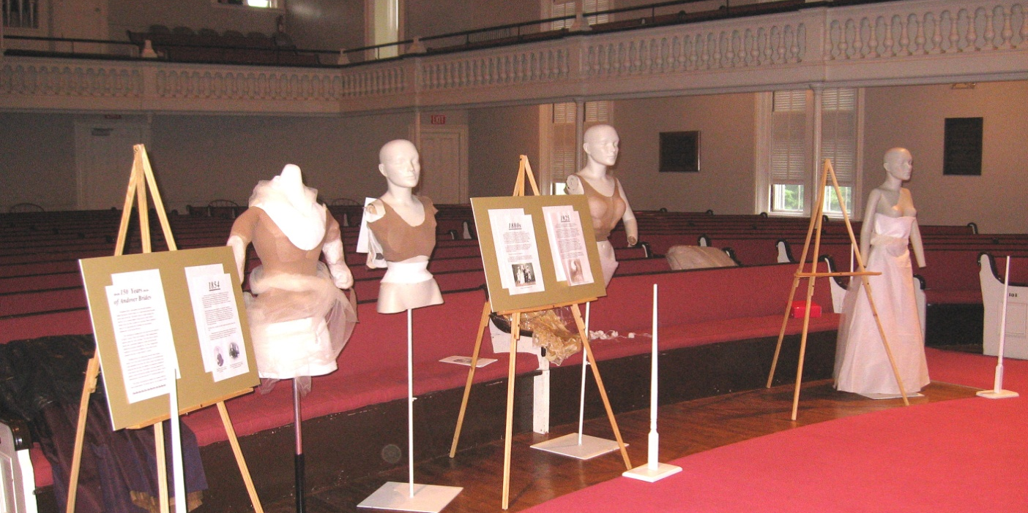
Cost Effectiveness
What is the budget for your costume-mounting project? What funding is needed for conservation treatments in order to stabilize and ready pieces for display?

Slide 20
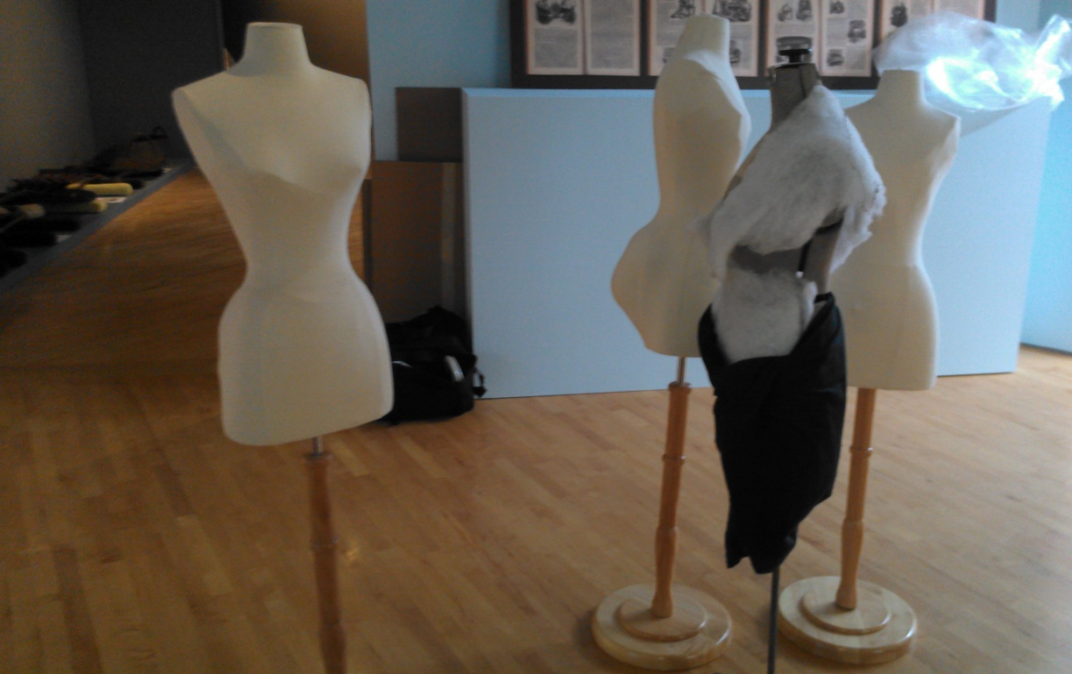
Archival Safety
Are the costume mounts made of archival-safe materials that will not harm the garments? What level of care is necessary for the garment?

Slide 21
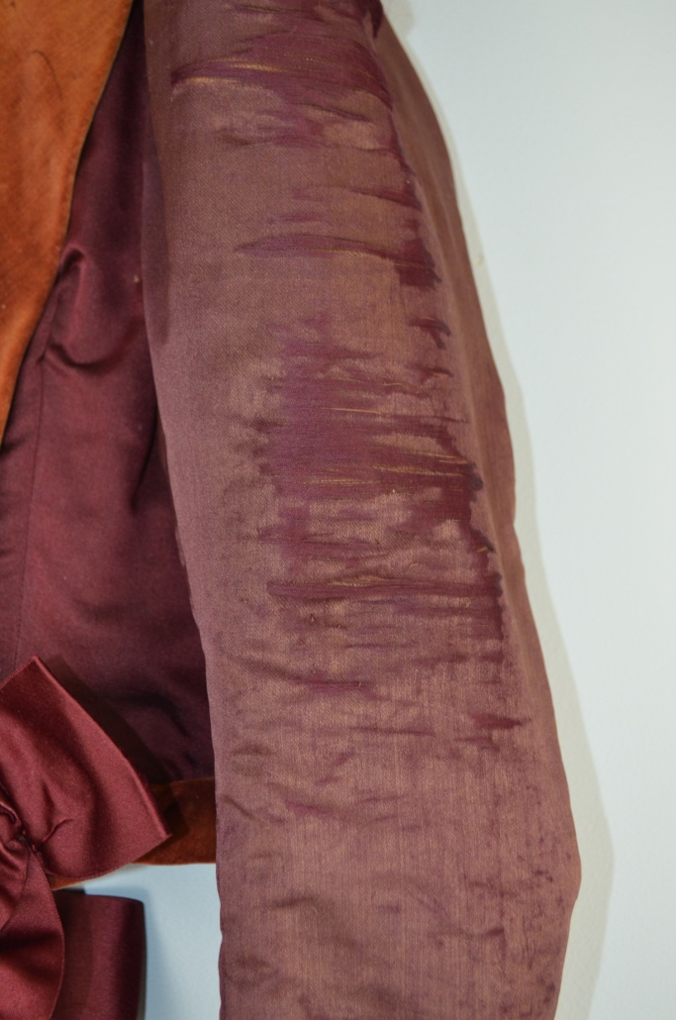
Garment Condition
Does the garment have any tears, weak areas, unstable elements, stains, or fading that might make them unsuitable for display?

Slide 22
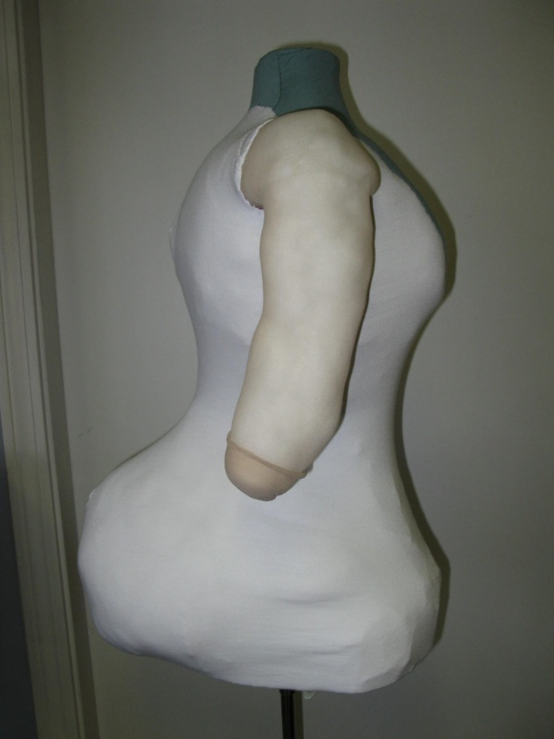
Garment Silhouette
Does the size and shape of your mount support the historic silhouette of the garment? If not, how easily can it be manipulated to correctly support it?

Slide 23
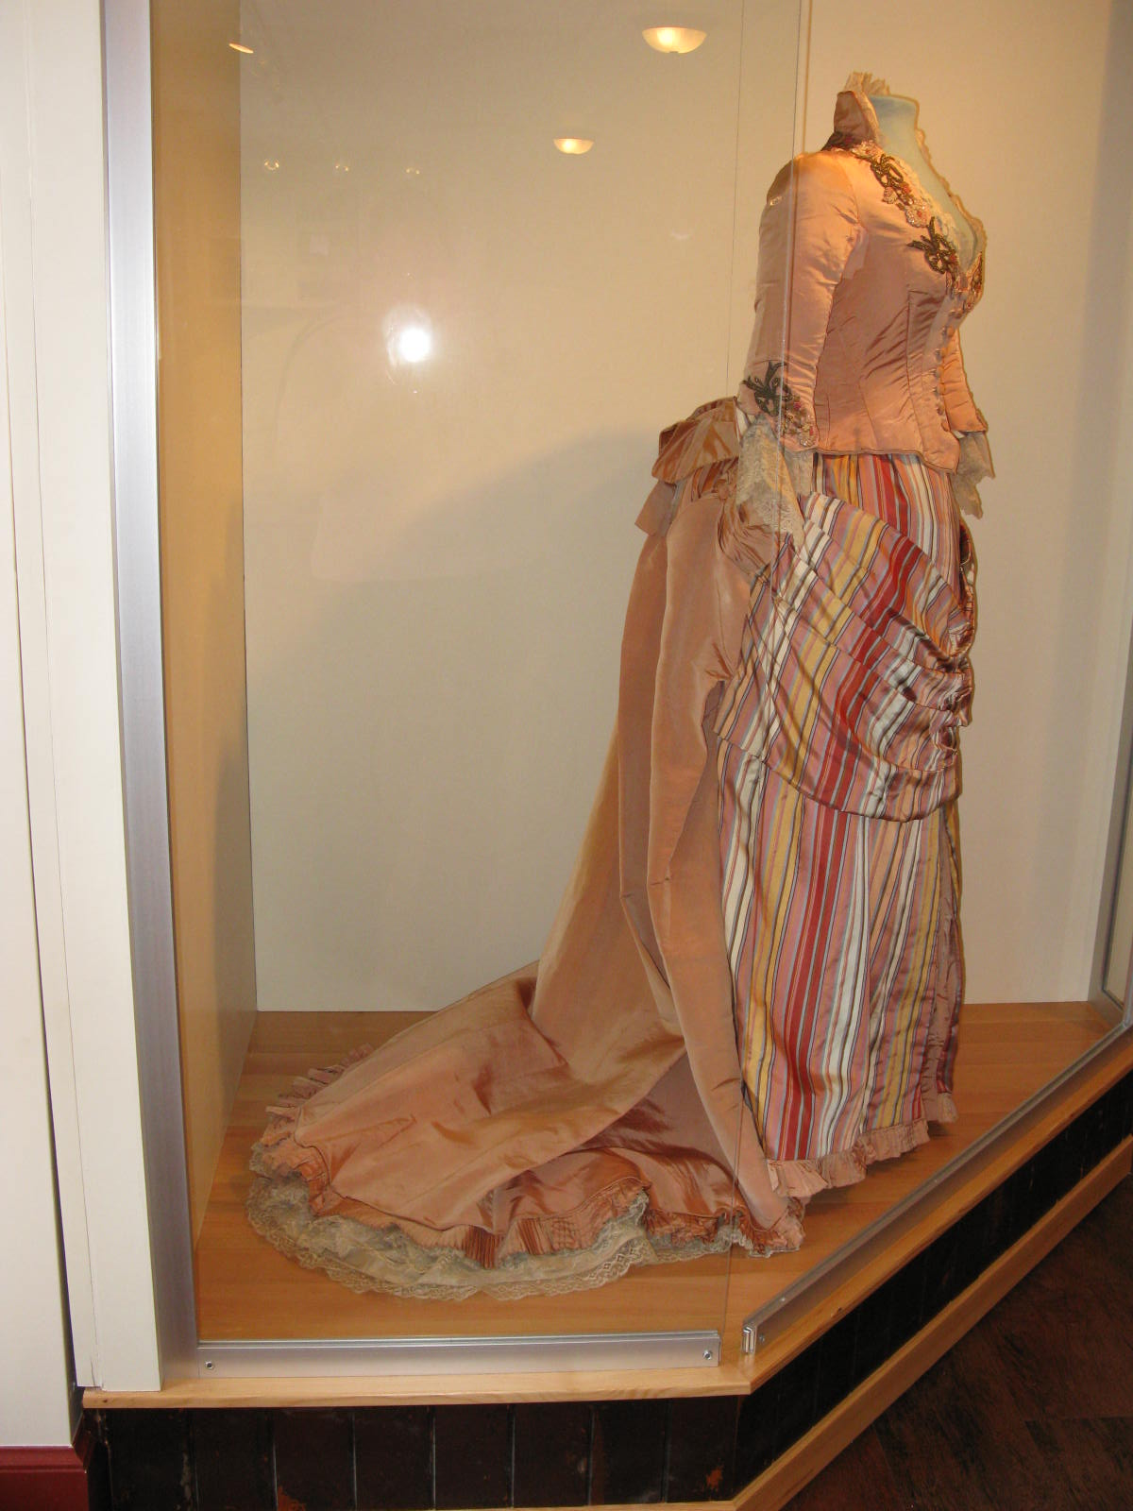
Garment Silhouette
Does the garment have a relatively simple silhouette that is straightforward to research and mount, or does it have more intricate details that require expert handling and knowledge?

Slide 24
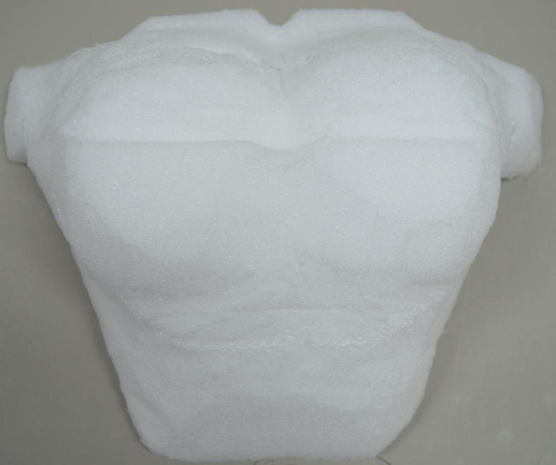
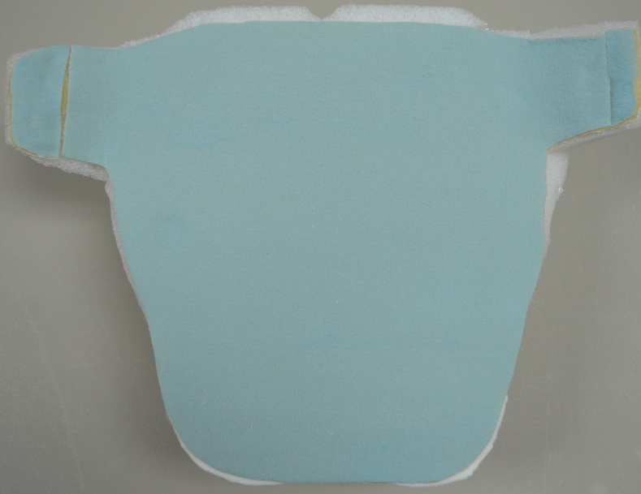
Versatility
Is the costume mount intended for one-time use or can it be repurposed for other exhibitions and garments? What size, shape, or gender is the costume mount compatible with?

Slide 25
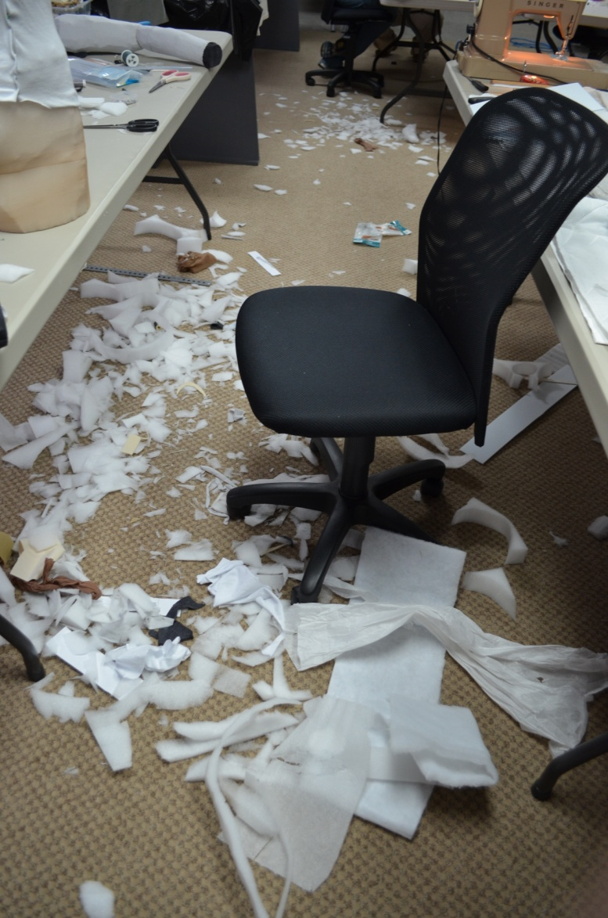
Time (and Space)
What kind of timeline does your exhibit need to meet? How much time can your staff set aside to safely dress each garment for display?

Slide 26
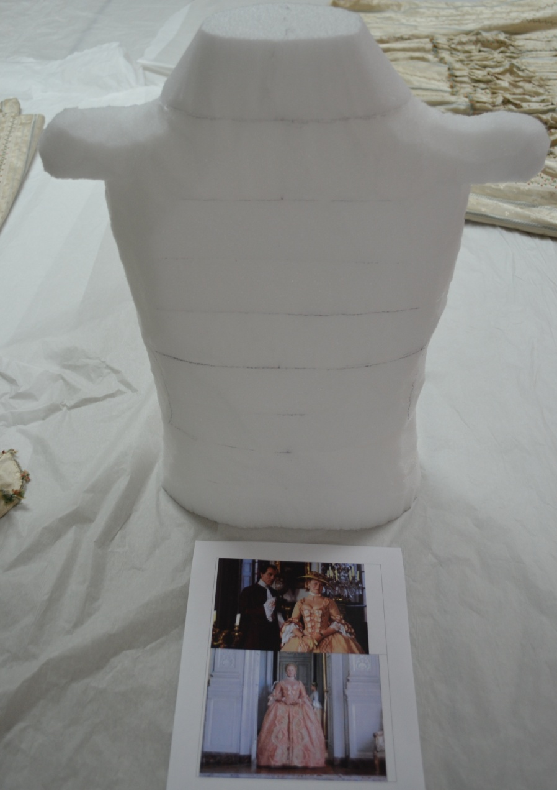
Staff Experience
Does your museum staff have working knowledge of handling textiles and basic sewing skills? How much curatorial research will be needed to accurately interpret the garments for an engaging display?

Slide 27
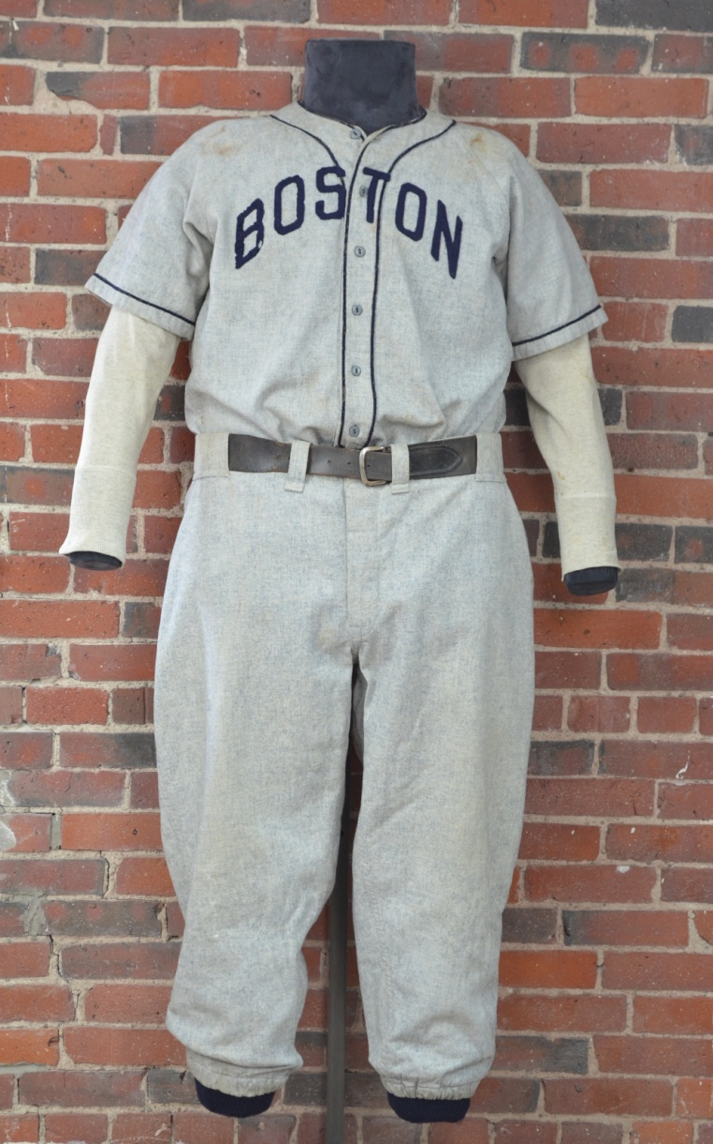
Exhibition Space
Will your exhibition space accommodate a full 3D form or do you require a solution for shallow space?

Slide 28
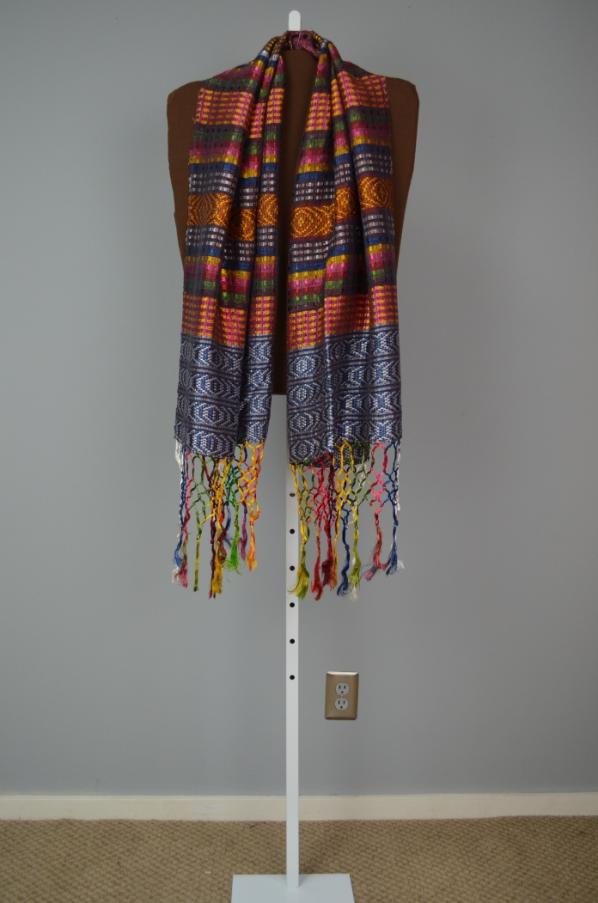
Suspension Form

Slide 29
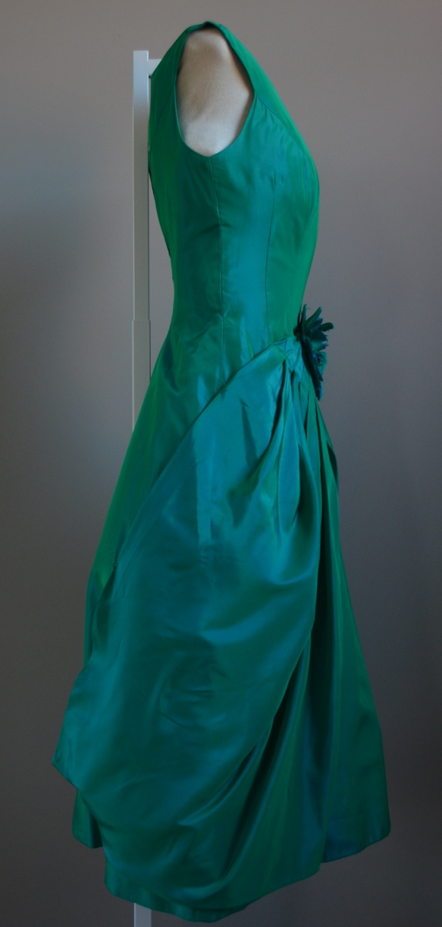

Slide 30
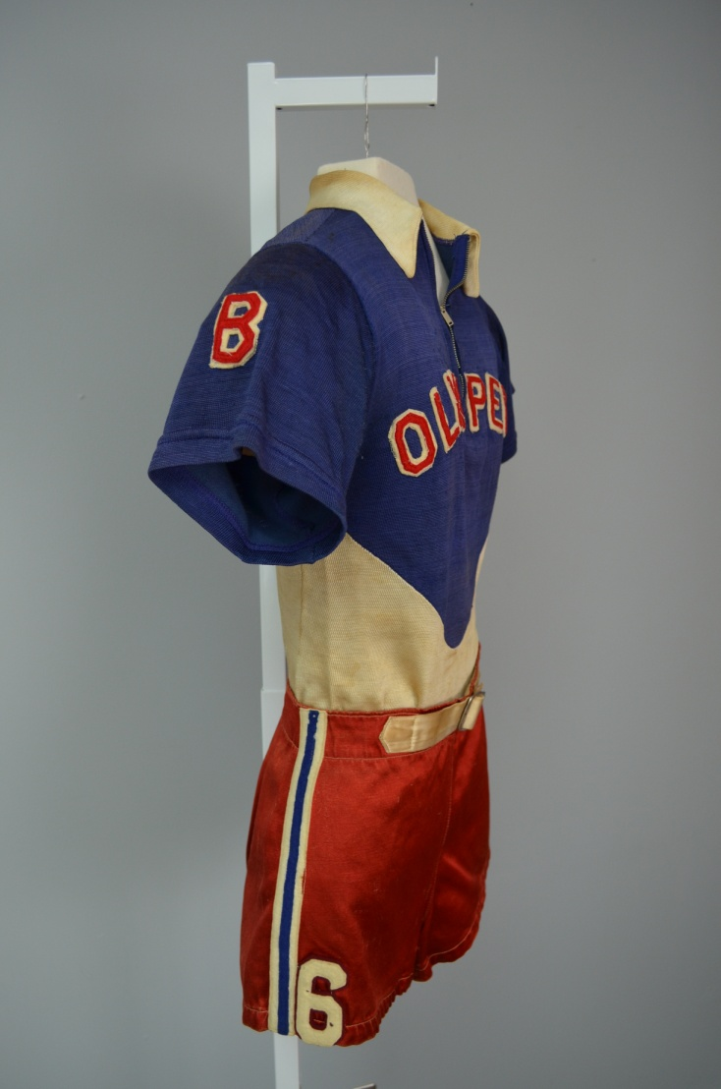

Slide 32
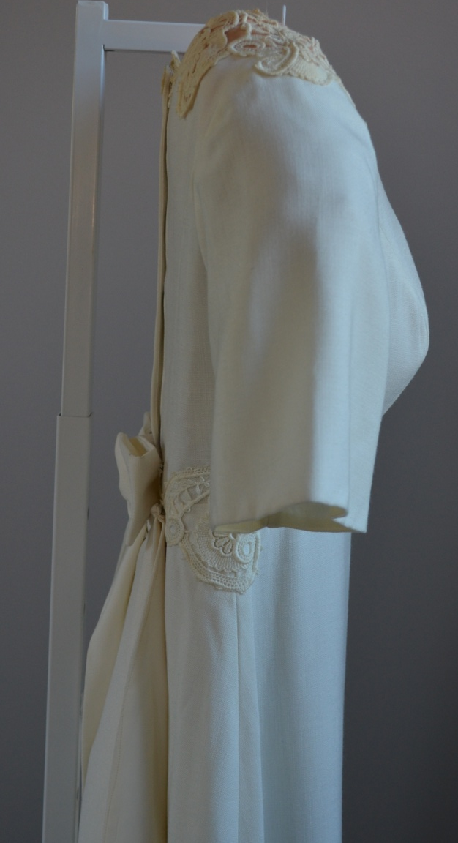

Slide 33
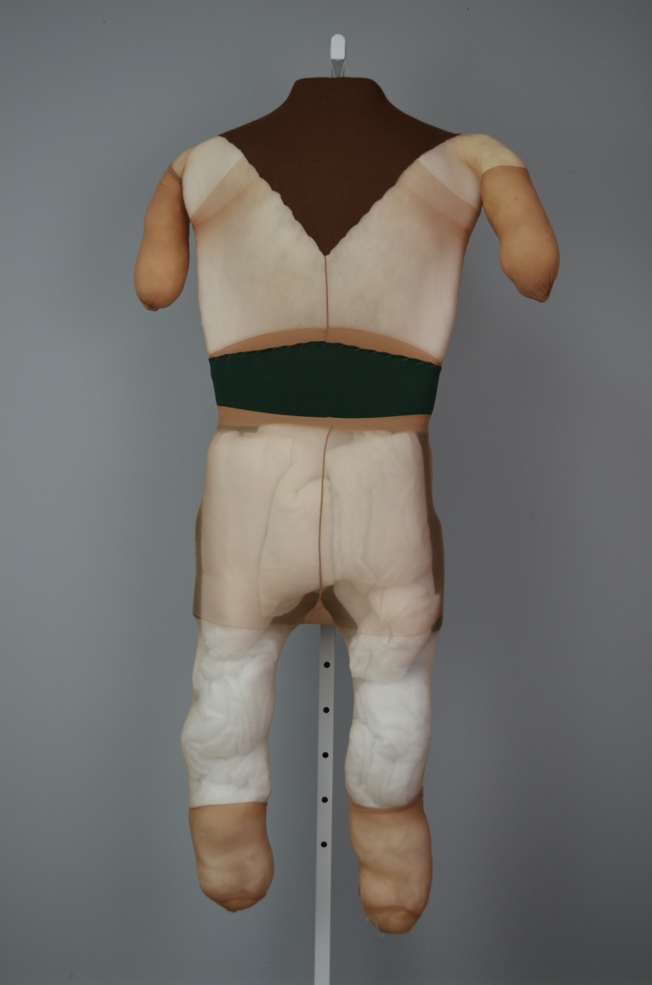

Slide 34
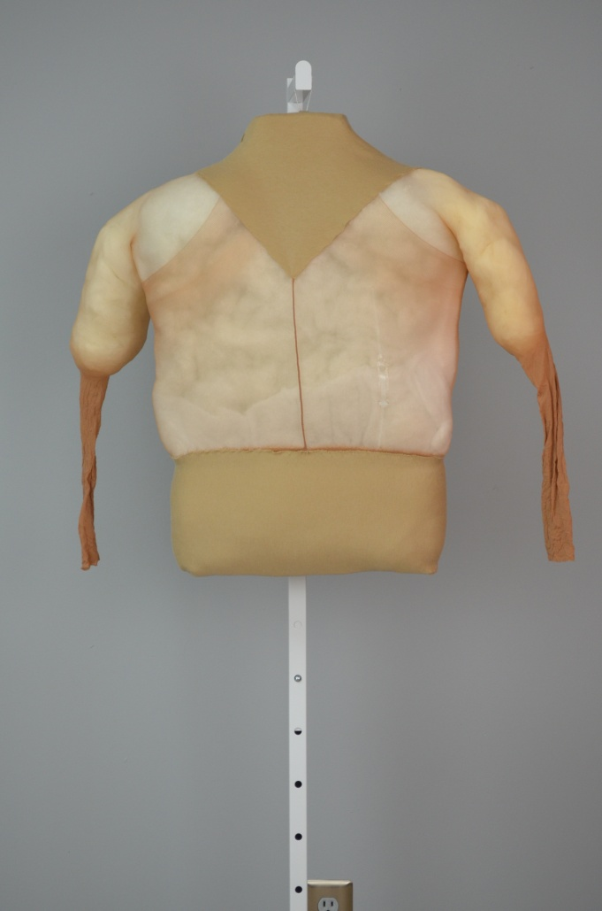

Slide 35
Manikins

Slide 36
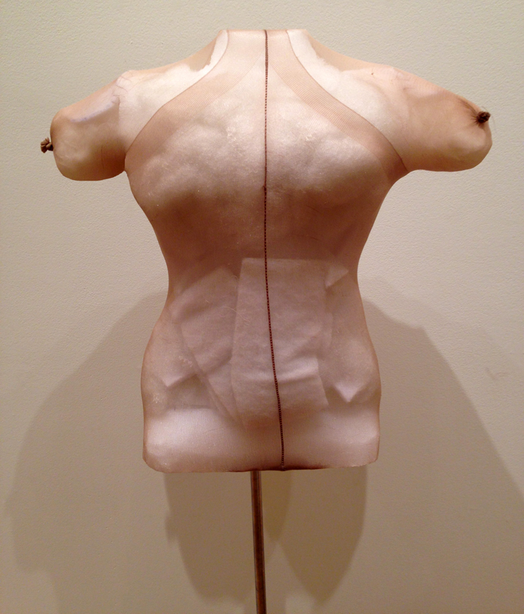

Slide 37
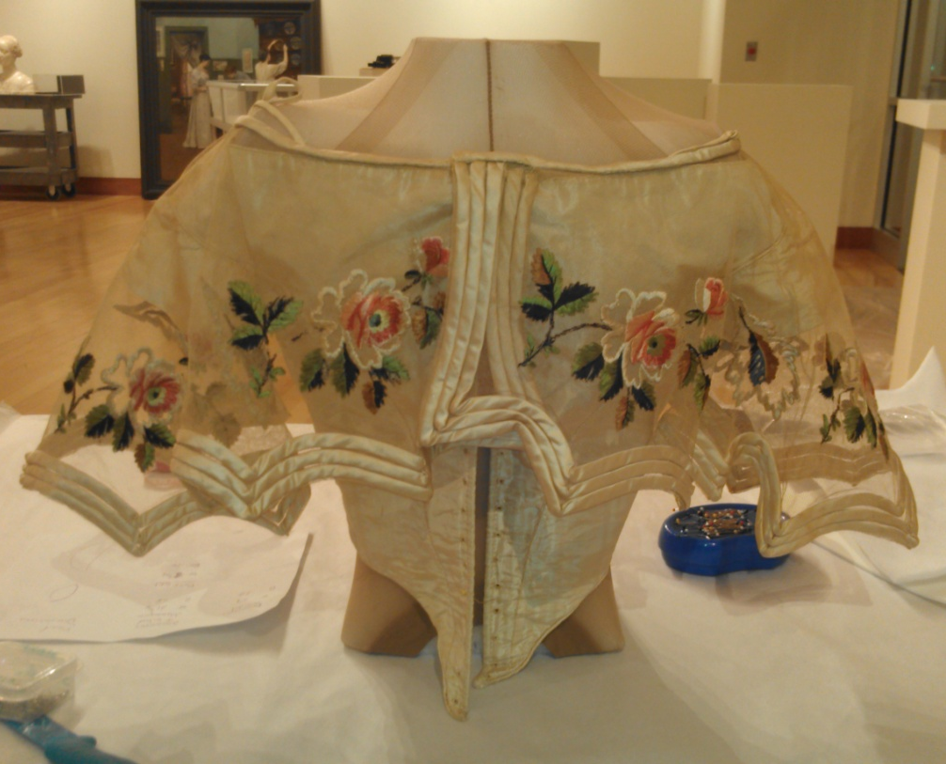

Slide 38
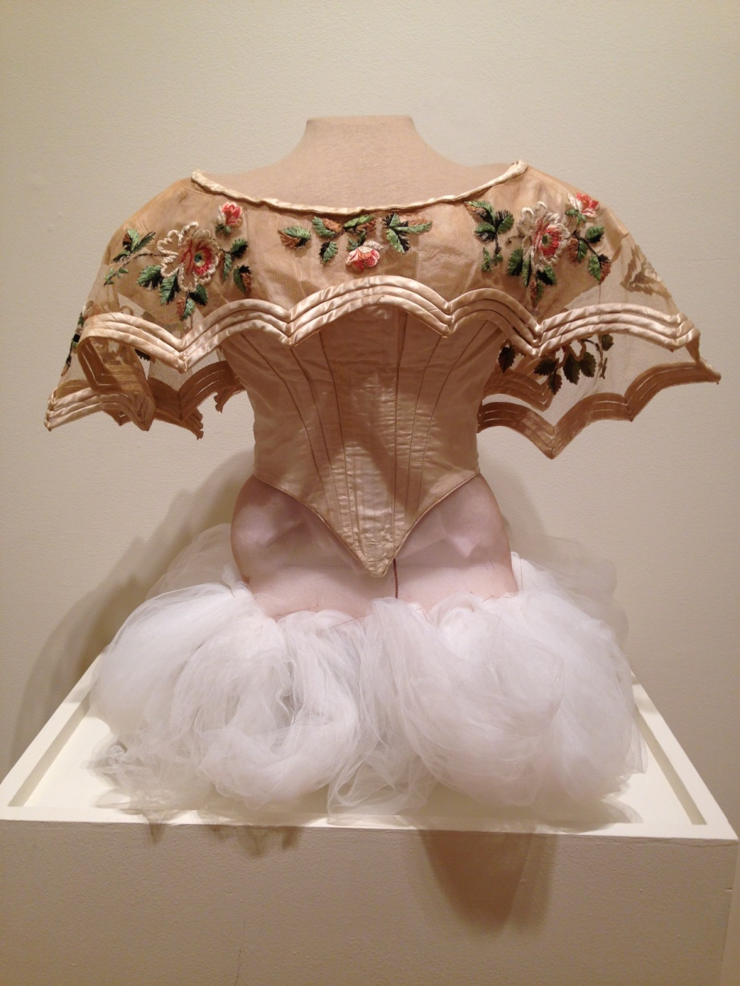

Slide 39
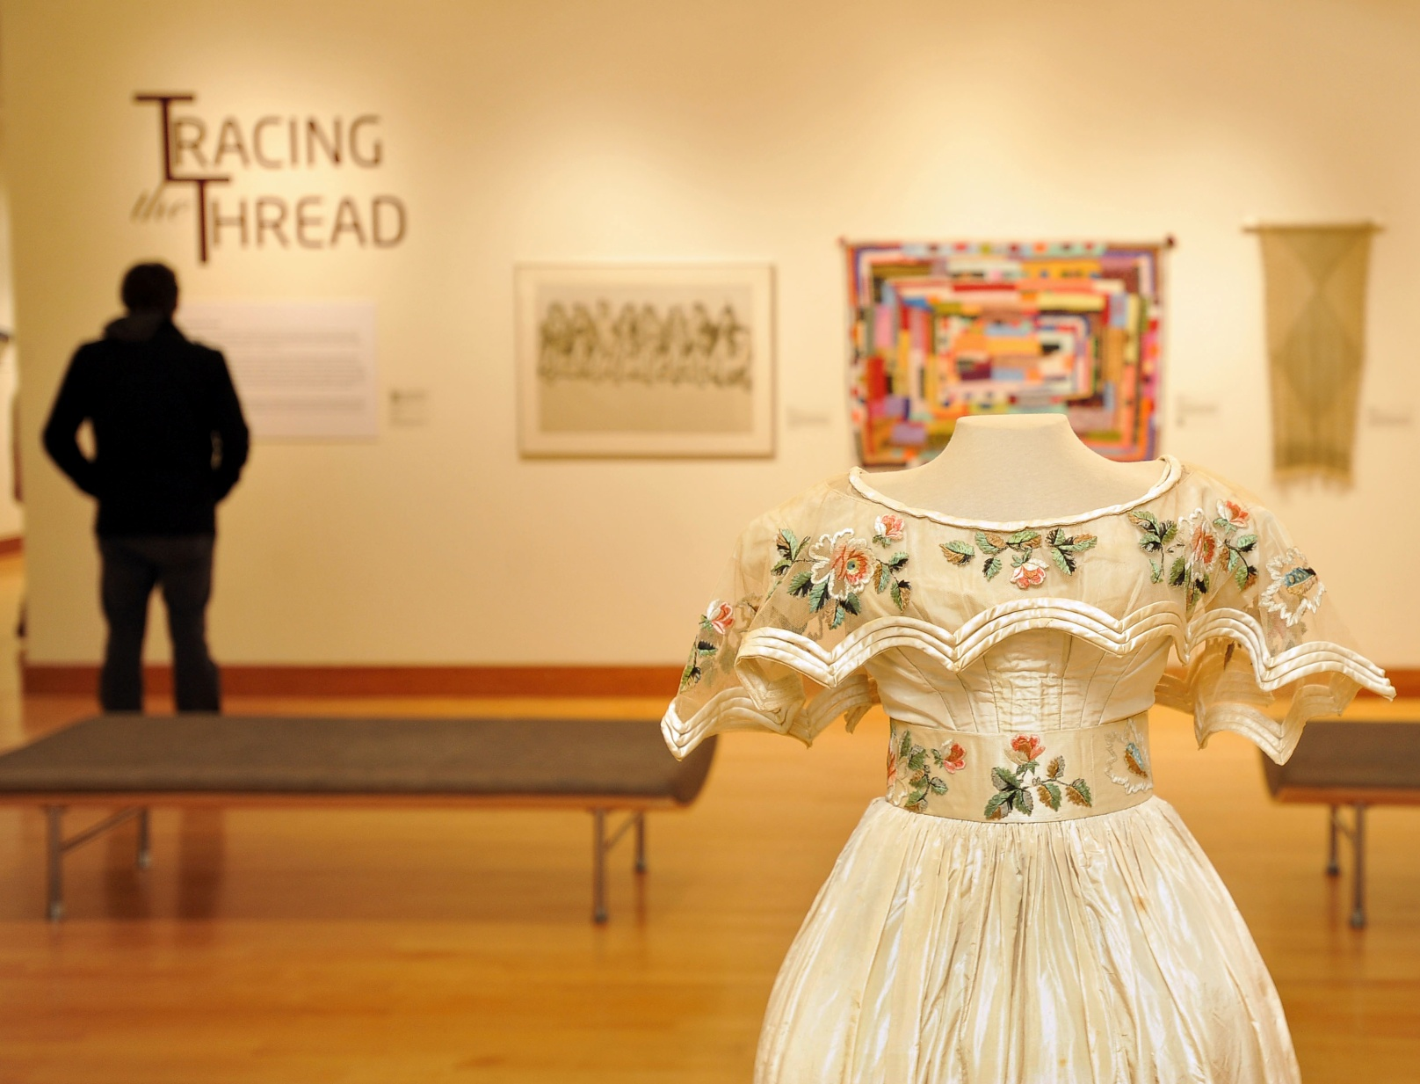

Slide 40
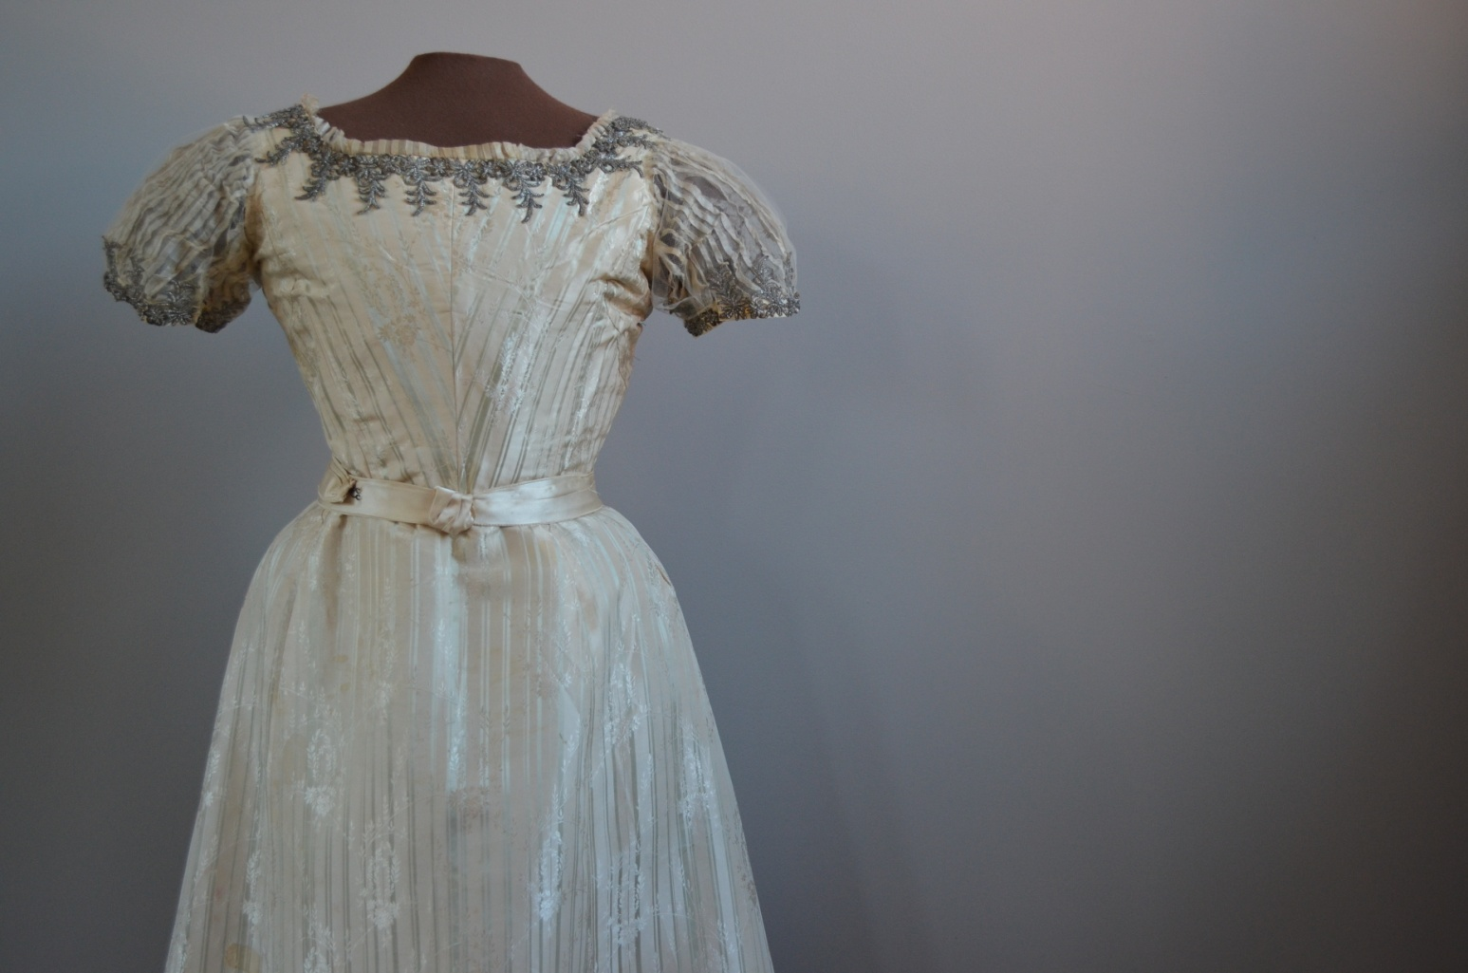

Slide 41
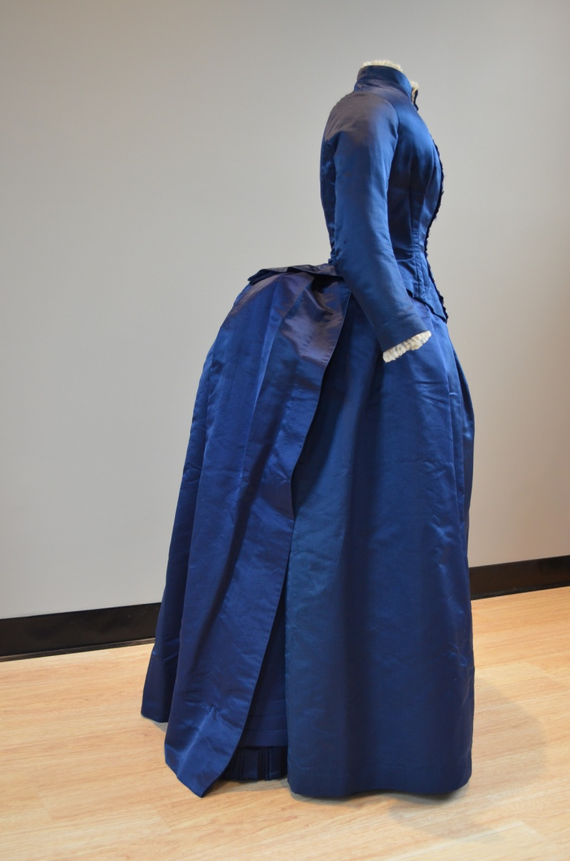

Slide 42
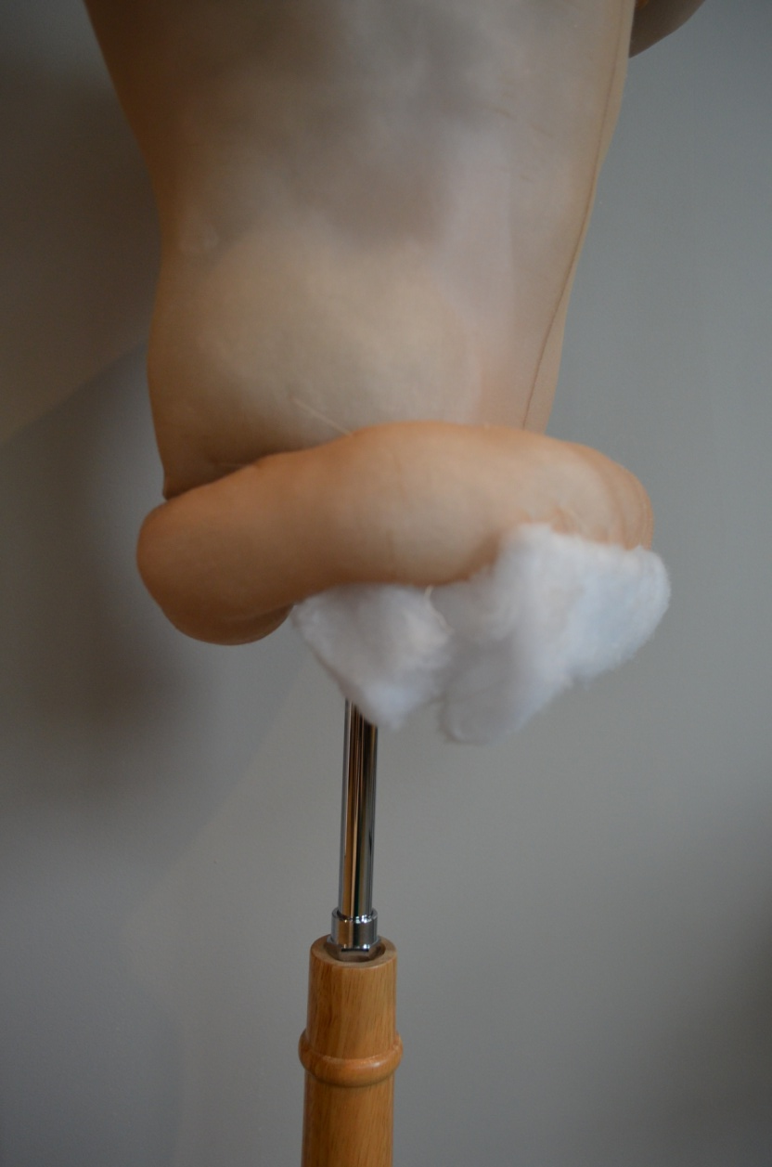

Slide 43
