Slide 1
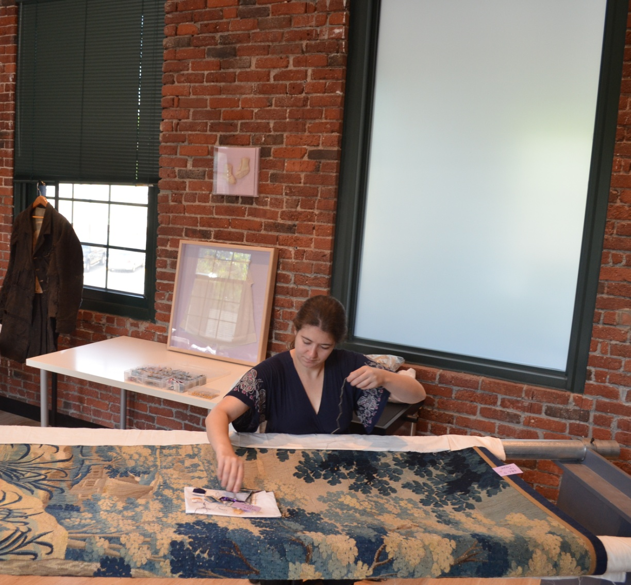
Case Studies in Textile Display

Slide 2
“Gold” Sampler

Slide 9
The Eliza Strong Embroidery

Slide 15
Cold Water Banner

Slide 16
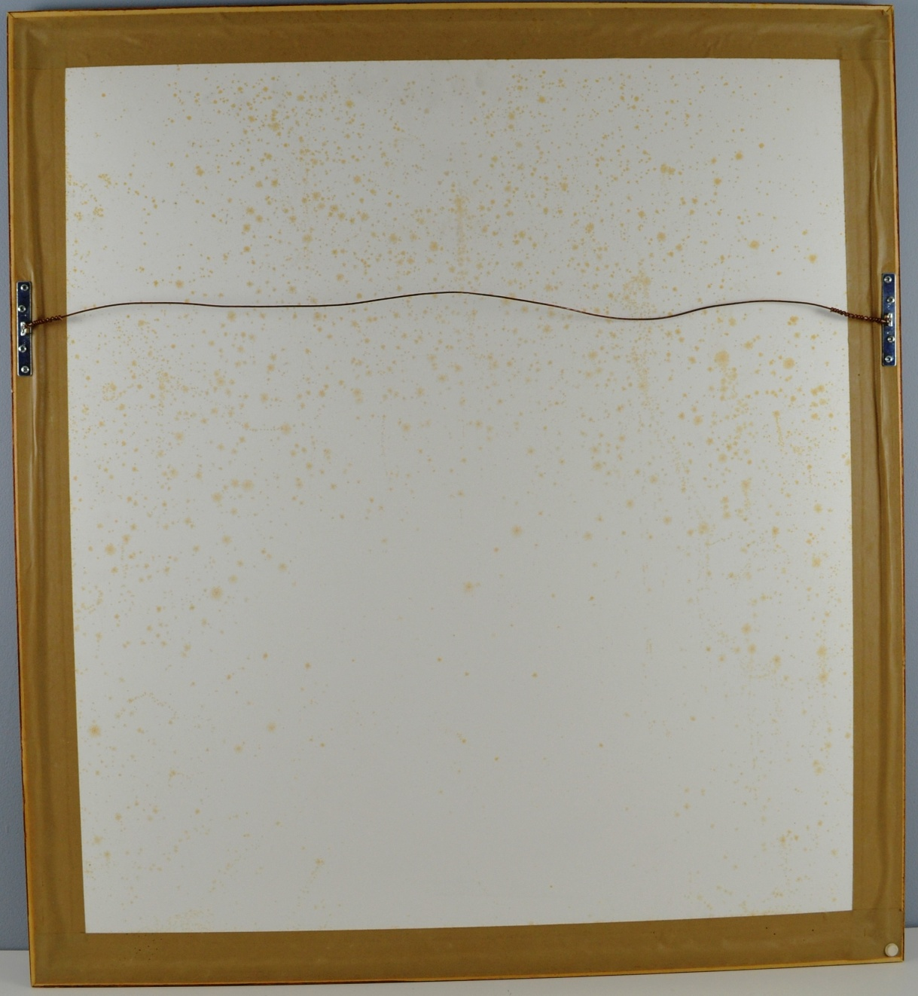

Slide 19
Spanish Alter Cloth

Slide 23
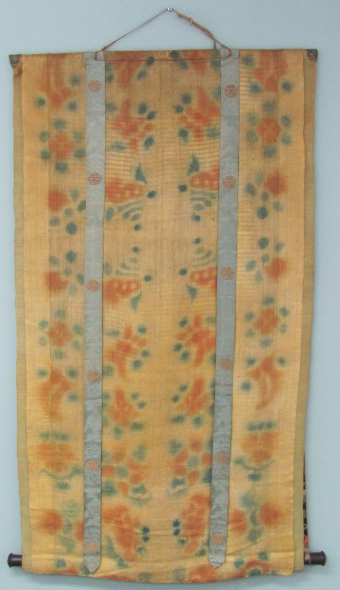
Thangkas

Slide 24
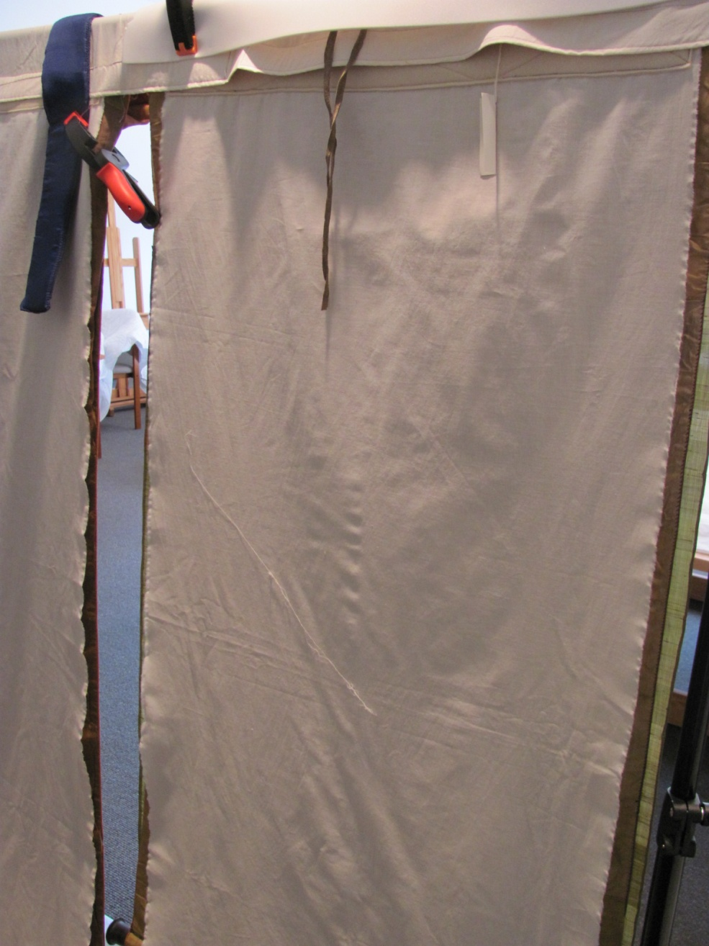

Slide 26
Displaying Larger Textiles

Slide 30
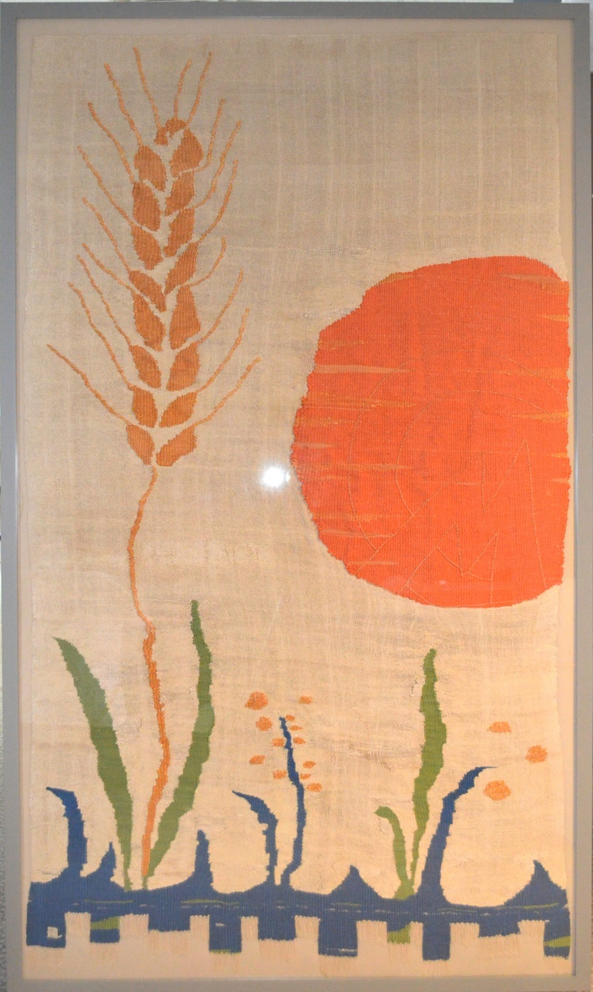

Slide 31
Flores Ikat

Slide 32
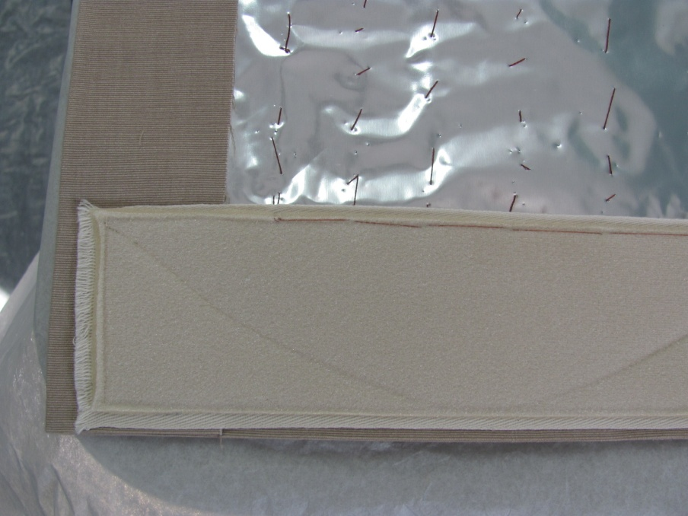

Slide 35
Tapestry

Slide 39
Flags

Slide 45
